Slide 1
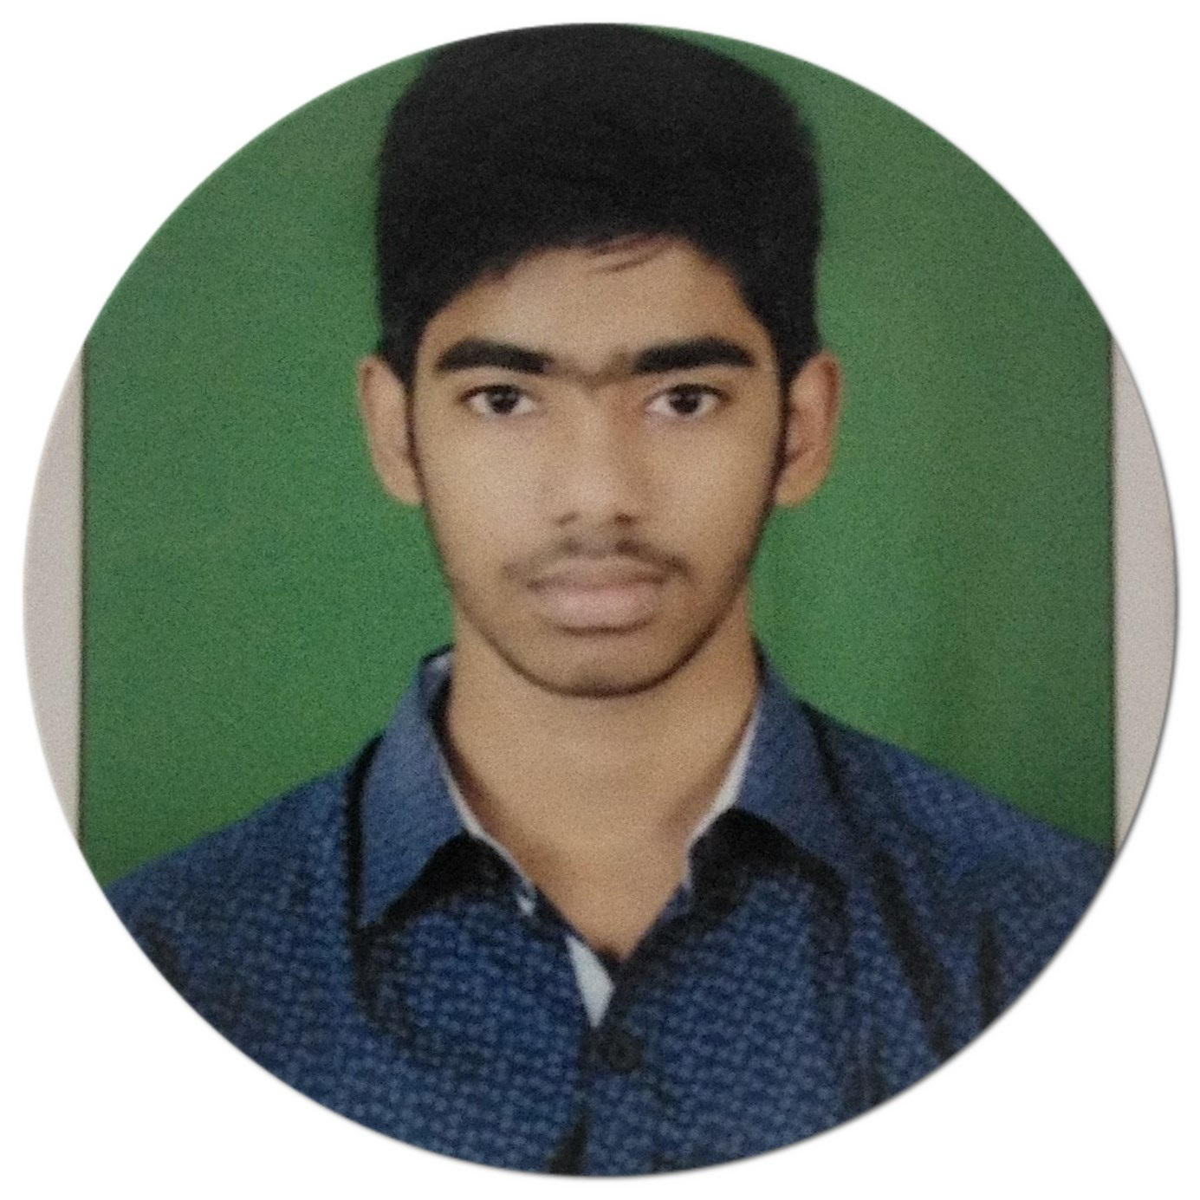



VENKATA CHAITANYA KAPA
Analyst/Software Engineer
Bachelor of Engineering
Electronics Communication Engineering : 2018- 2022
Skills
Java 8 /J2EE | Java Basics, OOPS, Collections, Arrays, Loops, , Stream API ,Junit, Mockito.
Spring core | IOC & Dependency Injection, Autowire
Spring REST | REST controllers, Implementation of GET, POST, PUT & DELETE, Bean Validation & Exception Handling, Testing Services, Controller & Repository layer
Spring Data JPA | Implement DAO layer using spring Data repositories, Transaction Management
Spring Boot Microservices | Spring Boot Starters, annotations, Swagger API documents
Spring Cloud | Eureka, Netflix Ribbon, Feign Client, Netflix Hystrix, Netflix Zuul & Config Server
React | Components, Event handling, Redux, Reducers
Database | MongoDB No Sql Basics My SQL RDS Basics
UI Tech | HTML 5 & CSS 3,JavaScript, Reusable templates, Optimized UI Designed
Tools | Git, Postman, Maven, IDE
Add On skills | Communications, Team management. Peer learning
Bangalore
venkatachaitanyakapa@gmail.com
+91 7981415433
A4
Full Stack Developer
Hands on experience in creating microservices with Spring boot, Spring Security, Spring Cloud API Gateway, Eureka Discovery server.
Hands on experience in building webpage using HTML, CSS Bootstrap,React.
Development experience using Eclipse ,VS Code, Intellij IDE , postman as API client ,Pg Admin for postgres Database and mongoDB Atlas.
E-Commerce Shopping Cart Application
Completed end to end case study of Shopping Cart Application along with authentication,MongoDB, Swagger and payment testing, responsive UI with CSS and ReactJs used for user interface.
Online Course Registration Demo(Backend)
Developed backend online course registration which is demo using Spring Boot, My SQL, Postman .
Check out my work on GitHub & Video Profile

